Slide 1
Name:
Grade:
Room Number:

Slide 2
Make the star spin on click, delete this message after

Slide 3
Swiper needs to fly in & out, delete this message after

Slide 4
Make Mr.Toad bigger and then smaller in size with animation
Change the background color to blue
Delete this message after

Slide 5
Give Teddy a friend. Can you copy & paste to clone him?
Add your choice of animation to both the bears
Delete this message after

Slide 6
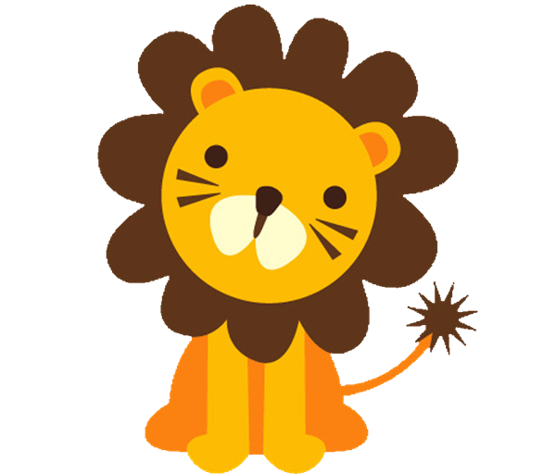
Make the lion fade in & out. Can you click in the call out and make him ask you a question? Delete this message after
Make me ask something

Slide 7
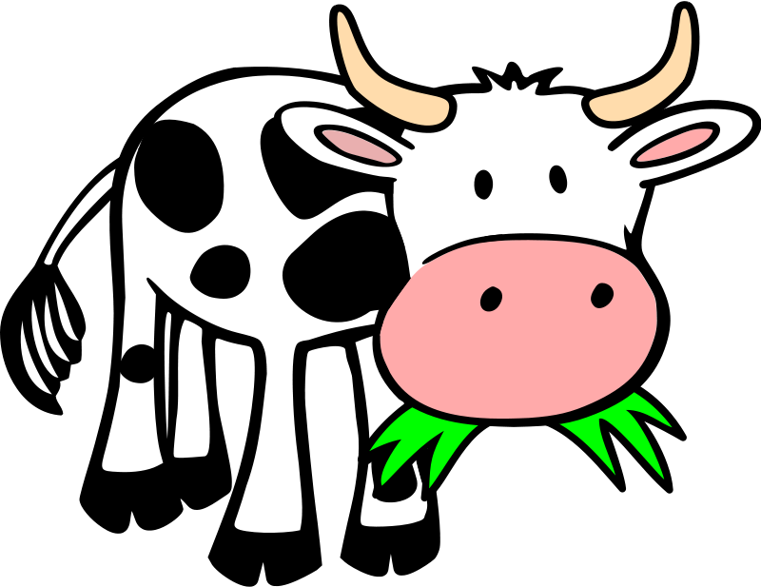
Insert a text box and write the name of the animal you see on this page.
Rotate the cow to make him lay on his back with his legs up in the air
Add transitions to your slideshow
Delete this message after

